Slide 1

GROUPBY 2021 | OCT 26-27
We'll be Online Shortly!

Slide 3
GROUPBY 2021 | OCT 26-27
Free Online Training for Data Professionals.
By the Community for the Community.

Slide 4
The Quick Version
We are dedicated to a harassment-free experience for everyone, regardless of who you are and what makes you you. We recognize the right of any individual to attend and participate. Anyone. This is included but not limited to gender identity and expression, sexual orientation, disability, physical appearance, body size, race, religion, or any other classification, affiliation, or label.
We do not tolerate harassment in any form. For the duration of your engagement with GroupBy and its programs, you are expected to act appropriately and to adhere to this Code of Conduct. This includes conduct in-person and online, at the conference itself, as well as any non-conference programs that may include participants: including talks, workshops, parties, on social media, and other online forums. GroupBy participants violating these rules may be sanctioned or expelled without a refund (if that applies) at the discretion of the conference organizers.
You can review the full policy at: GroupBy.org/Code-of-Conduct
Notes:
You do not need to read this full policy, just give people time to read this and explain they can review the full policy at the provided link.

Slide 5

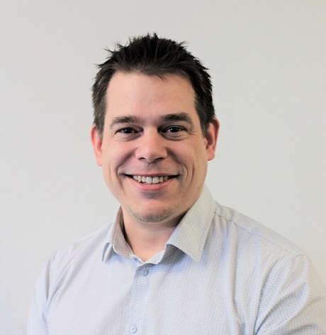
Adrian Sullivan
Principal Consultant – Modern Data
lexel.co.nz, sqldba.org
linkedin.com/in/milliondollardba
I’m SQL DBA, doing DBA things for around 15 years. I run a SQL Practice in Auckland, NZ. My speciality is Professional Services and Managed Services built around SQL data platforms. I ❤️ SQL server projects.

Slide 6




GROUPBY 2021 | OCT 26-27
Core Sponsors
Media Sponsors
Virtual Group Sponsors

Slide 7
Session outline
Part 1
Part 2
Intro
What can go wrong
Questions
Short break
Learnings
Demo
Questions
End

Slide 8

“We are looking into it. Well, um, I am looking into it.”

Slide 9
Do you SQL project, bro?
Let me give you a breakdown

Slide 10
What does a $1million SQL project look like
Hardware and Software - $830k
Services – $550k
Storage, $127k
Compute, $271k
SQL licensing, $433k
Think 15 large SQL clusters
Application upgrade project ($2million) - Not included
Design, $75k
Implementation & Test, $243k
Migration & Cutover, $121k
Managed Services, $103k

Slide 11
What does a $1million SQL team look like
Contractor
Client
Principal Consultant - me
Project Coordinator
Senior DBAs
Advisory consultants
Project Managers
IT Support Team
Business Unit Leads
Vendors

Slide 12

Oops

Slide 13
Where can it go wrong?
Requirements
Risk analysis
Vendors
Stakeholder engagement
Migration tools
Scale
Hardware lifecycle
Project timelines
Project resources
Team size
Client team
SQL Upgrade path
Cutover downtime

Slide 14
Where did it go wrong for me?
Requirements
Risk analysis
Vendors
Stakeholder engagement
Migration tools
Scale
Hardware lifecycle
Project timelines
Project resources
Team size
Client team
SQL Upgrade path
Cutover downtime

Slide 15
What went wrong?
Missed requirements
Ignored security risks
Vendors don’t like AGs
Missed decision makers
Tools impacted downtime
CPU clock speeds to low
Couldn’t get HCI
Behind schedule
People dragged into support
Team too small
Project manager change
Compatibility level issues
Downtime too long

Slide 16
“We don’t rise to the level of our expectations; we fall to the level of our training.” — Archilochus c. 680–645 BC
Surprisingly, failures have been around for a quite a while.

Slide 17
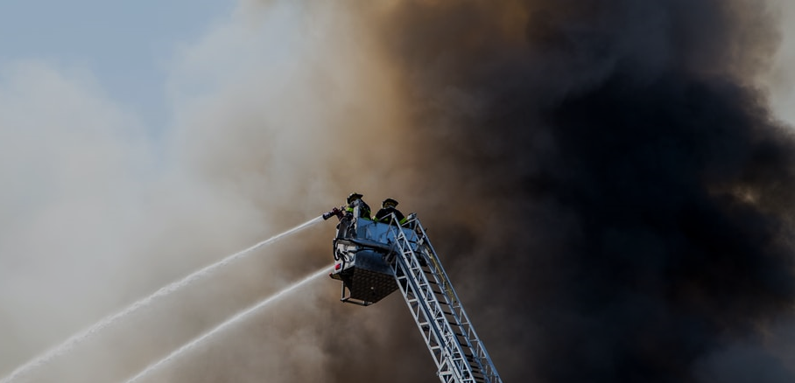
“We are looking into it. Well, um, I am looking into it. Well, we have identified several issues and will be briefing your PMs this afternoon.”

Slide 18
GROUPBY 2021 | OCT 26-27
Question time

Slide 19
GROUPBY 2021 | OCT 26-27
We're taking a short break
Sessions will resume soon!

Slide 20

Let’s get back to having fun

Slide 21
What did I learn?
Requirements
Tie requirements back to testing. In that way everyone agrees on deliverables.
Have the client sign off on requirements.
Include them in your design.
What if it goes wrong?
Risk analysis
Talk to the client about a worst-case outcome.
Be realistic.
Things will break, talk to the PM about it.
What if it goes wrong?

Slide 22
What did I learn?
Vendors.
Talk to each one during design.
Make sure they match requirements.
Compatibility levels are key
What if it goes wrong?
Stakeholder
Engagement. Talk to everyone, all the time.
If you're not talking to them, they are talking to each other about you.
What if it goes wrong?

Slide 23
What did I learn?
Migration tools
Keep it simple.
If you can’t do it with DBAtools, DMA or Log shipping then you’re doing it wrong.
What if it goes wrong?
Scale & Hardware
Are they buying 2GHz CPUs or 4GHz CPUs? NVMe or SSD? You need to know about these things.
Get an expert in the room with you.
What if it goes wrong?

Slide 24
What did I learn?
Project timelines
Get a PM to help you.
Add 35%.
Add 15%.
Add another 5%.
You can always deliver faster.
What if it goes wrong?
Project resources
Do you have the skills to deliver this?
Have you worked together on another project?
What if it goes wrong?

Slide 25
What did I learn?
Team size
Do you have capacity to deliver this project?
Do you need a PM to manage your internal team?
Small teams are best.
What if it goes wrong?
Client team
Make best friends with the Project Manager.
Treat their team like you’d like to be treated.
Ask questions if you are not sure.
What if it goes wrong?

Slide 26
What did I learn?
SQL Upgrade path
SQL 2019 can run compatibility 100 databases
Test anything pre-SQL 2014 on SQL 2016, if it works then you’ll be good.
Data Migration Assistant
What if it goes wrong?
Cutover downtime
Aim for a reasonable time, 4 hours.
Do this in the middle of the week where possible, it’s hard to get hold of people on weekends.
What if it goes wrong?

Slide 27
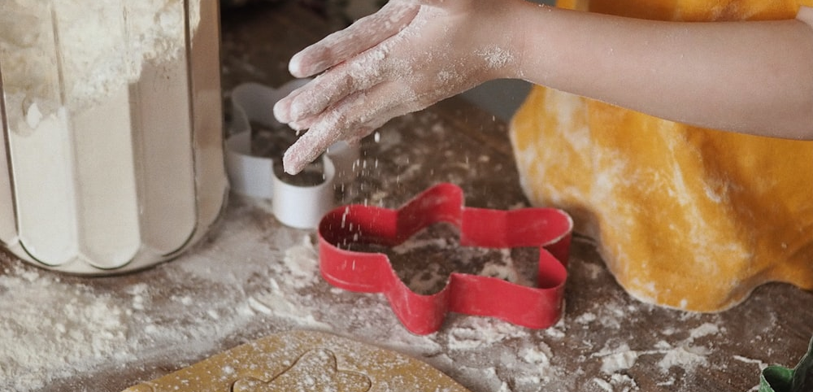
Demo time

Slide 28
The Sullivan framework for not breaking SQL projects
Assume everything will break.
Document everything in your design.
Have the client agree on everything in your design.
Build what you designed.

Slide 29
GROUPBY 2021 | OCT 26-27
Question time

Slide 30
GROUPBY 2021 | OCT 26-27
Core Sponsors
Media Sponsors
Virtual Group Sponsors

